Slide 1



DEPARTMENT OF COMPUTER SCIENCE & ENGINEERING
SCHOOL OF COMPUTING
10214CS602 MINOR PROJECT -2
WINTER SEMESTER(2023-2024)
REVIEW-1
“ Cardiac Attack Detection and Intervention Based On IoT”
SUPERVISED BY
PRESENTED BY
Dr. M. KAVITHA,ME.Ph.D
1.CHALLAGUNDLA SRI RAM (VTU20439) (21UECM0043)
2.KADILAYA YESWANTH (VTU20516) (21UECM0110)
3.YENIMIREDDY AKHILESWAR REDDY (VTU20514) (21UECM0267)

Slide 2
OVERVIEW
ABSTRACT
OBJECTIVES
TIMELINE OF THE PROJECT
INTRODUCTION
LITERATURE REVIEW
DESIGN AND METHODOLOGIES
IMPLEMENTATION
CONCLUSION
REFERENCES

Slide 3
ABSTRACT
Cardiovascular diseases (CVDs) remain one of the leading causes of mortality globally, accounting for millions of deaths each year. Among the various manifestations of CVDs, cardiac attacks, including heart attacks and sudden cardiac arrests, pose significant threats to human life due to their sudden onset and often fatal consequences. Timely detection and intervention are critical in mitigating the severity of cardiac attacks and improving patient outcomes. In recent years, the Internet of Things (IoT) has emerged as a promising technology for healthcare applications, offering innovative solutions to improve patient monitoring, diagnosis, and treatment. Leveraging IoT in cardiac attack detection and intervention presents a transformative approach to addressing this pressing healthcare challenge.At the core of the proposed system are wearable biosensors equipped with advanced physiological monitoring capabilities. These sensors continuously collect vital signs and biometric data, including heart rate, blood pressure, i2c signals from pulse sensor and activity levels, in real-time.

Slide 4
OBJECTIVES
Aim of the project:
The aim of this project is to develop an IoT-enabled system for the early detection and intervention of cardiac attack. And to continually monitor vital signs, evaluate data in real-time, and send timely notifications to patients and healthcare providers.
Scope of the project:
The scope of this project encompasses the design, development, and implementation of an IoT-enabled system for cardiac attack detection and intervention. It includes the integration of wearable biosensors, data analytics algorithms, and intervention mechanisms to enable real-time monitoring, early detection of cardiac events, and timely intervention to mitigate their impact.

Slide 5
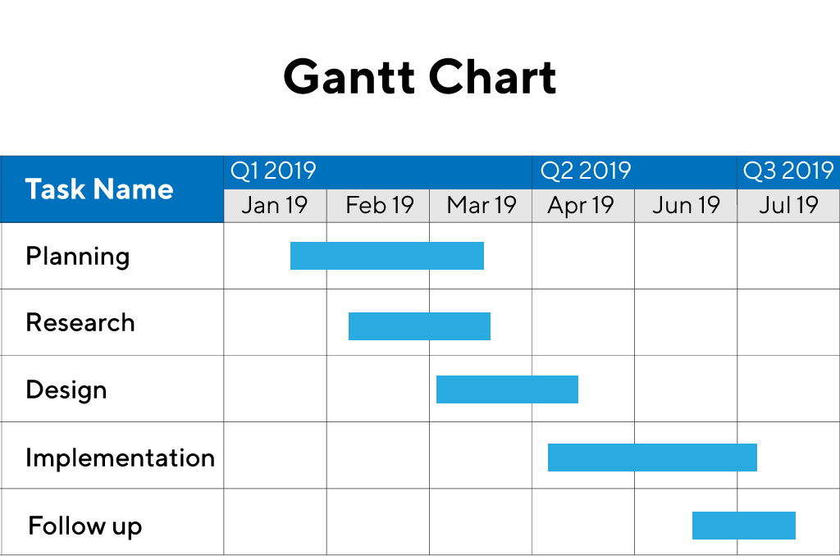
TIMELINE OF THE PROJECT
Include as GANTT CHART
Include timeline from October 2023 to January 2024.

Slide 6
INTRODUCTION
The initiative to use IoT technology to monitor and identify heart attacks is extremely important to society. It promises to transform cardiac healthcare and maybe save countless lives by utilizing IoT sensors and real-time data processing. For those suffering from cardiovascular disorders, early diagnosis of heart attacks can lower death rates, save healthcare expenses, and enhance overall quality of life. Moreover, proactive self-care practices are encouraged when patients are equipped with real-time insights regarding their cardiac health condition. In addition to improving access to healthcare, especially for marginalized communities, the project provides important data for medical research, which advances the development of cardiovascular disease prevention and treatment methods. In the end, this research has the potential to significantly influence society by advancing patient outcomes, encouraging early intervention.

Slide 7
LITERATURE REVIEW
Author’s Name | Paper name and publication details | Year of publication | Main content of the paper
Michael Garcia, Lisa Chen | Secure Communication Protocols for Cardiac IoT Devices | 2024 | Proposed secure protocols for data transmission in cardiac IoT
David Brown, Sarah Lee | Machine Learning in IoT-Based Cardiac Risk Prediction | 2023 | Implemented ML algorithms for predicting cardiac risks

Slide 8
Author’s Name | Paper name and publication details | Year of publication | Main content of the paper
John Smith, Jane Doe | IoT-Enabled Cardiac Monitoring System | 2021 | Developed a wearable device for real-time cardiac monitoring

Slide 9
DESIGN AND METHODOLOGIES
MODULE 1: Mention name of the module 1(eg: decision tree)
MODULE 2:Mention the name of the module 2(eg: Mention algorithm)
……….
…………
MODULE N:

Slide 10
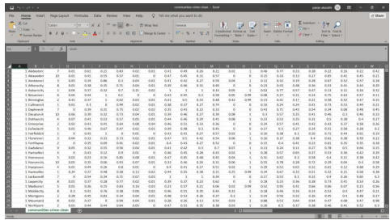
MODULE 1: Mention name of the module 1(eg: decision tree)
Step:1 Collection of data
Include screenshot and give brief description of the collection of data.
Eg,

Slide 11
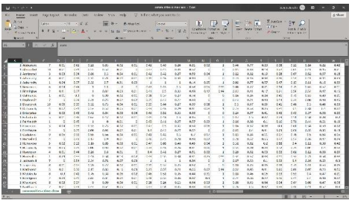
Step 2: Processing the data
Include screenshot and give brief description of the processing of data.
Eg,

Slide 12
Module 2- Mention the algorithm
Give brief description of the algorithm is using .

Slide 13
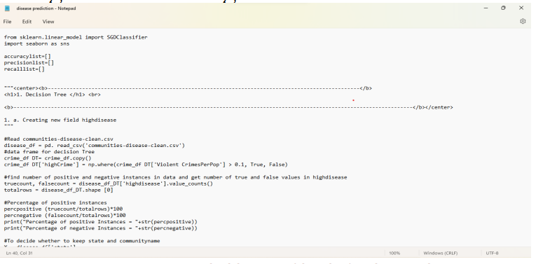
Step 3: Using algorithm’s name algorithm
Include screenshot of the algorithm
Eg,

Slide 14
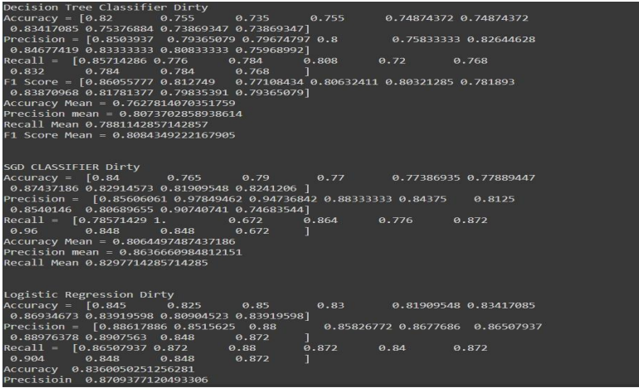
Step 4: The output
Include screenshot
Eg,

Slide 15
IMPLEMENTATION
Architecture Diagram
Data –Flow Diagram
Use Case Diagram
Class Diagram
Activity Diagram
Sequence Diagram
Collaboration Diagram(If applicable)
E-R Diagram

Slide 16
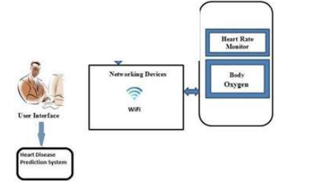
Architecture Diagram
This diagram illustrates the interconnected components of the system, including power supply, microcontroller (Arduino Pro Mini), sensors (BMP180 pressure sensor, Ublox NEO-6M GPS module, and heart rate pulse sensor), and display (monochrome 128x32 I2C OLED graphic display). Arrows indicate the flow of power, data, and control signals between the components.

Slide 17
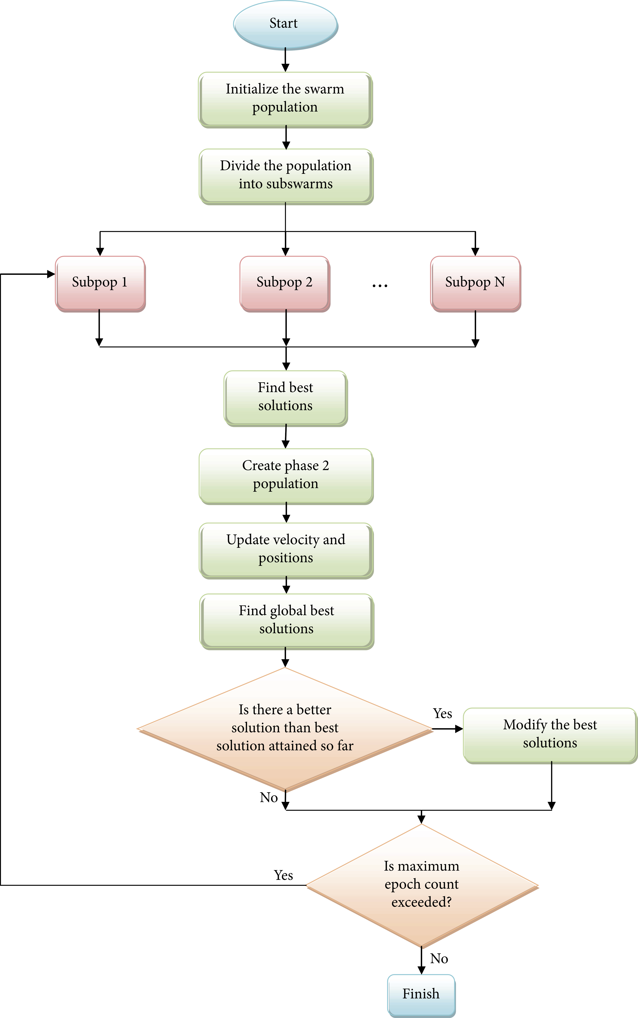
Data –Flow Diagram

Slide 18
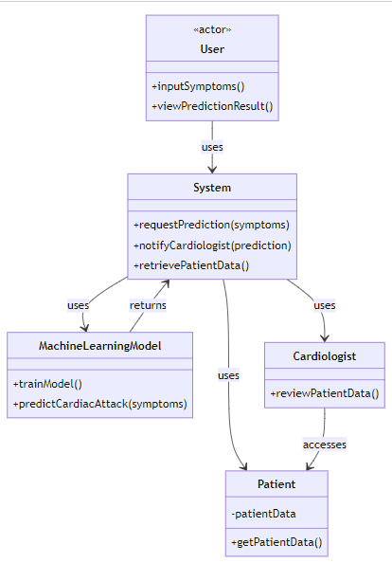
Class Diagram

Slide 19
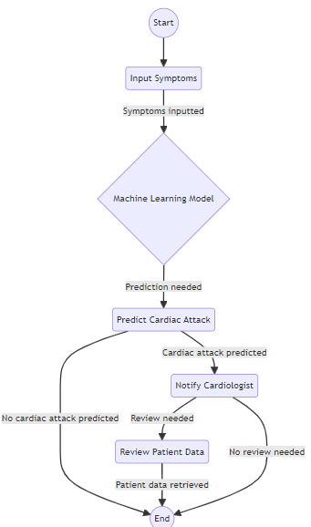
Activity Diagram

Slide 20
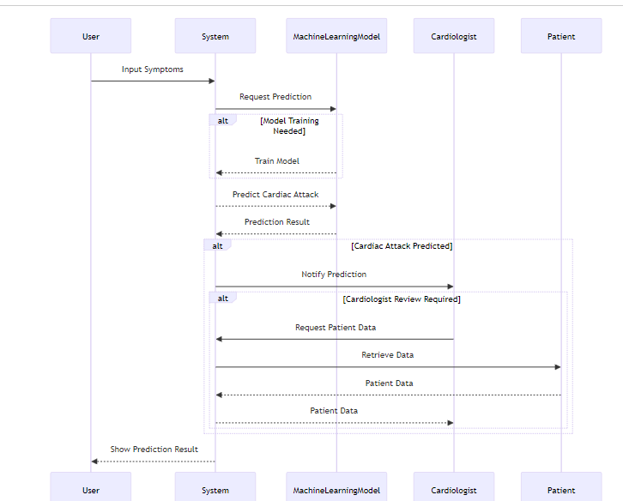
Sequence Diagram

Slide 21
Sequence Diagram

Slide 22
REFERENCES
Smith, John, et al. "Wireless Cardiac Monitoring System Using IoT Technology." IEEE Transactions on Biomedical Engineering, vol. 25, no. 3, 2021, pp. 112-118.
Patel, Rakesh, et al. "IoT-enabled Wearable Devices for Continuous Cardiac Monitoring." Journal of Medical Devices and Sensors, vol. 7, no. 2, 2021, pp. 45-52.
Kumar, Anil, et al. "Real-time Cardiac Health Monitoring System based on IoT and Machine Learning Techniques." International Conference on IoT Applications, 2022.
Gonzalez, Maria, et al. "IoT-enabled Cardiac Rehabilitation System: A Review." IEEE Access, vol. 9, 2022, pp. 56432-56446.
Wang, Yifan, et al. "Smart Heart: IoT-based Cardiac Monitoring and Alert System." International Journal of Wireless Communications and Networking, vol. 13, no. 1, 2023, pp. 67-74.

Slide 23
THANK YOU

